Slide 1

Implementando e Projetando WebSites
Evilázaro Alves
Microsoft Regional Director | Microsoft Azure MVP
www.evilazaro.com.br
evilazaro@gmail.com
@evilazaro

Slide 2



Evilázaro Alves | @evilazaro
Colocar informações sobre o instrutor aqui

Slide 3
Agenda
Introdução
Implantando WebApps;
Configurando WebApps;
Configurando diagnostics, monitoramento, e analytics;
Implementando web Jobs;
Configurando webapps para escalabilidade e resiliência;
Desenhando e Implementando aplicações para escalabilidade e resiliência;

Slide 4

Azure App Service

Slide 5


Azure App Service
Web Apps
Mobile Apps
Logic Apps
API Apps

Slide 6
Desenvolva apps com...
.NET | Node.js | PHP | Python | Java

Slide 7
Benefícios do App Service
Atualização automática do SO
Projetado para implemantar os mais rígidos padrões de segurança;
Alta disponibilidade
Scale out/in automático
Load Balancing por padrão (nativo)
Suporte a múltiplas linguagens e plataformas
.NET, Node.js, Python, Ruby e muito mais
Fácil implementação de Continuous Deployment
Continuous delivery a partir dos principais source control providers
Git repo nativo

Slide 8



Web Apps
Logic Apps
Mobile Apps
Administração da APP
Site
Pedido completado com sucesso
App
http
SQL
API Apps
Notes:
WebApp
Crie aplicativos Web dimensionáveis
Codifique na sua linguagem e IDE favoritos – .NET, NodeJS, PHP, Python ou Java – para criar aplicativos Web e APIs mais rápido do que nunca. Seja mais rápido com a integração contínua usando o Visual Studio Team Services ou o GitHub e com a depuração de site ativo. Dimensione facilmente aplicativos sob demanda com alta disponibilidade.
Mobile App
Aplicativos móveis atraentes
Crie aplicativos móveis atraentes para iOS, Android e Windows. Adicione logon corporativo com facilidade e se conecte aos recursos locais com segurança. Crie aplicativos robustos que permanecem úteis mesmo onde há problemas de rede, para que os usuários possam criar e modificar dados mesmo quando estiverem offline. Difunda notificações por push personalizadas para milhões em minutos.
Logic App
Integração simples
Automatize os processos empresariais rapidamente com uma experiência de design visual para processos empresariais e fluxos de trabalho. Integre-se com seu SaaS e aplicativos empresariais com conectividade integrada a dezenas de serviços baseados em nuvem e aplicativos empresariais. Pronto para a empresa, com funcionalidades do Biztalk para automatizar EAI/B2B e o processo empresarial.

Slide 9
WebApps

Slide 10
Introdução
Hospedagem de Aplicações Web PaaS
Provê uma Plataforma como Serviço para hospedagem de aplicações Web sejam elas webpages ou web services;
Gerenciamento
Gerenciamento do ciclo de vida da aplicação como:
Configurações de continuous delivery e continuous deployment em ambientes de staging e production;
Gerenciamento de configurações em tempo de execução;
Monitoramento da saúde e dados de diagnósticos da aplicação;
Configurações de escalabilidade e resiliência
Notes:
Azure Websites provides a Platform-as-a-Service (PaaS) approach for hosting your web applications, whether they are webpages or web services. The platform approach provides more than just a host for running your application logic; it also includes robust mechanisms for managing all aspects of your web application lifecycle, from configuring continuous and staged deployments to managing runtime configuration, monitoring health and diagnostic data, and, of course, helping with scale and resilience. Related to Azure Websites, WebJobs enables you to perform background processing within the familiar context of Websites. These key features are of prime importance to the modern web application, and this chapter explores how to leverage them.
Tejada, Zoiner; Bustamante, Michele Leroux; Ellis, Ike. Exam Ref 70-532 Developing Microsoft Azure Solutions (p. 1). Pearson Education. Kindle Edition.

Slide 11
Introdução
Processamento em background
WebJobs possibilita que sua aplicação rode processos em background no mesmo context de seu WebApp;
Notes:
Azure Websites provides a Platform-as-a-Service (PaaS) approach for hosting your web applications, whether they are webpages or web services. The platform approach provides more than just a host for running your application logic; it also includes robust mechanisms for managing all aspects of your web application lifecycle, from configuring continuous and staged deployments to managing runtime configuration, monitoring health and diagnostic data, and, of course, helping with scale and resilience. Related to Azure Websites, WebJobs enables you to perform background processing within the familiar context of Websites. These key features are of prime importance to the modern web application, and this chapter explores how to leverage them.
Tejada, Zoiner; Bustamante, Michele Leroux; Ellis, Ike. Exam Ref 70-532 Developing Microsoft Azure Solutions (p. 1). Pearson Education. Kindle Edition.

Slide 12



Microsoft Azure
Your Datacenter
Virtual Machines
Cloud Services
Web App
Aplicações
Aplicações
Aplicações
Aplicações
Dados
Dados
Dados
Dados
Firewall
Firewall
Firewall
Rede
Rede Virtual
Rede Virtual
S/O
S/O
Virtualização
Hardware
Foco na Aplicação
Notes:
Slide Objectives:
Explain the differences between traditional self-hosting and the three options of Windows Azure hosting.
Notes:
In a traditional environment you must manage the full stack. With Windows Azure you can choose a variety of options depending on your needs.

Slide 13
Capacidades WebApp:
.NET, Node.js, Java, PHP, e Python
WebJobs para tarefas de longa duração
Publicação, depuração remota Integradas ao Visual Studio
Continuous Integration com GitHub, BitBucket, VSO
Auto-load balance, Autoscale, Geo DR
Rede virtual e conexões híbridas
Site slots para deployments em Staging

Slide 14
App Service WebApp
App Service Web App
Web Site
Monaco
MSDeploy
Build/Upload Your Own
Kudu
Web Jobs
Gallery
Public Site Extensions
Private Site Extensions
Azure App Service Web App

Slide 15
Criando uma WebApp
Notes:
Demo 1 - Creating a Web App
This is a quick demo showing how quickly you can create a new Web App in the portal. Feel free to change alter this first demo.
Browse to the Azure Portal
Click New / Web + Mobile / Web App.
Enter a unique name in the URL field and click the Create button.
While the site is being created, explain that Azure is provisioning a new Web App for you with supporting services, monitoring, support for continuous deployment, etc.
Note: This generally takes 30 - 60 seconds. During this time, you can ask them how long it would take their IT department or hosting provider to provision a new site for them. This is usually enough time for the new Web App to be created.
When the site comes up, scroll through the various features (Monitoring, Usage, Operations, Deployment, Networking) explaining that these are all live and have been provisioned with the Web App. You can click on the settings option to bring up the settings blade.
Note: If these tiles are not visible, you can add them by clicking on 'Add tiles' button and add Deployment, Operations, Usage etc.
Click on the Browse button. When the default landing page loads, point out that the page illustrates the different options for publishing to the new site, including Git, FTP, Visual Studio, etc.
Back in the portal, Under 'General' option select 'Application settings'. Show that .NET, PHP, Python and Java are all shown.

Slide 16
App Service Web App Architecture
Deployment
Server(s)
File Server
Publish Endpoint
Blob Storage
Application Database
Frontend (IIS ARR)
Microsoft Azure
Load Balancer
Metering
Runtime Database
API Endpoint

Slide 17
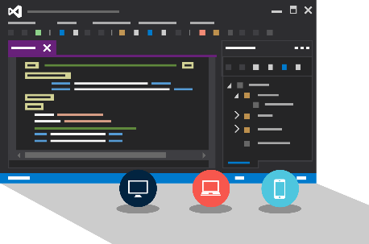
Visual Studio + App Service Web Apps
Gerencie recursos do Microsoft Azure com a Server Explorer

Slide 18
Demo: Criando uma WebApp com a Server Explorer
Notes:
Demo 1 - Creating a Web App
This is a quick demo showing how quickly you can create a new Web App in the portal. Feel free to change alter this first demo.
Browse to the Azure Portal
Click New / Web + Mobile / Web App.
Enter a unique name in the URL field and click the Create button.
While the site is being created, explain that Azure is provisioning a new Web App for you with supporting services, monitoring, support for continuous deployment, etc.
Note: This generally takes 30 - 60 seconds. During this time, you can ask them how long it would take their IT department or hosting provider to provision a new site for them. This is usually enough time for the new Web App to be created.
When the site comes up, scroll through the various features (Monitoring, Usage, Operations, Deployment, Networking) explaining that these are all live and have been provisioned with the Web App. You can click on the settings option to bring up the settings blade.
Note: If these tiles are not visible, you can add them by clicking on 'Add tiles' button and add Deployment, Operations, Usage etc.
Click on the Browse button. When the default landing page loads, point out that the page illustrates the different options for publishing to the new site, including Git, FTP, Visual Studio, etc.
Back in the portal, Under 'General' option select 'Application settings'. Show that .NET, PHP, Python and Java are all shown.

Slide 19



Deployment
Definir deployment slots e como realizar Roll back deployments
Criar hosting plans
Migrar websites entre hosting plans
Criar um website com um hosting plan

Slide 20
Introdução
Perguntas que devemos fazer quando consideramos mover nosso WebApp do nosso ambiente local (desenvolvimento) para o Microsoft Azure
Como deployments sequentes podem afetar usuarios existetntes do site?
Como minimizar o impacto de um deployment com defeitos / problemas?
Como garantir um consumo balanceado dos Recursos de cada instância do meu WebApp balanceando a carga, custo e ainda assim, garantir o SLA?
Notes:
When you are ready to move beyond local development of your website to make it accessible to the Internet at large, you have quite a few things to consider. For example, how will subsequent deployments affect existing users of your site? How can you minimize the impact of broken deployments? How can you achieve the right level of website density per instance so that you balance cost with performance and still leverage the Azure Websites SLA? To make the right decisions, you need to understand how to deploy websites to deployment slots, how to roll back deployments, and how to manage hosting plans.
Tejada, Zoiner; Bustamante, Michele Leroux; Ellis, Ike. Exam Ref 70-532 Developing Microsoft Azure Solutions (p. 2). Pearson Education. Kindle Edition.

Slide 21

Métodos de publicação suportados
FTP://
TFS
WebDeploy
DropBox
Notes:
Git Deployment is Native, or through a Service hook from CodePlex, GitHub or BitBucket

Slide 22

Continuous Deployment
Production Slot
Agilidade através do Continuous Deployment
Auto-Swap
Hooks
Git pull
Commits
Changes
Staging Slot
Source Control / Code Repo
Developer

Slide 23

Source Control
Git
Visual Studio
Online
CodePlex
GitHub
BitBucket
DropBox
FTP
Notes:
Slide Objectives:
Objective #1
Transition:
Transition statement(s) to setup the slide
Speaking Points:
Speaking Point #1
Speaking Point #2
Notes:
Any notes go here

Slide 24
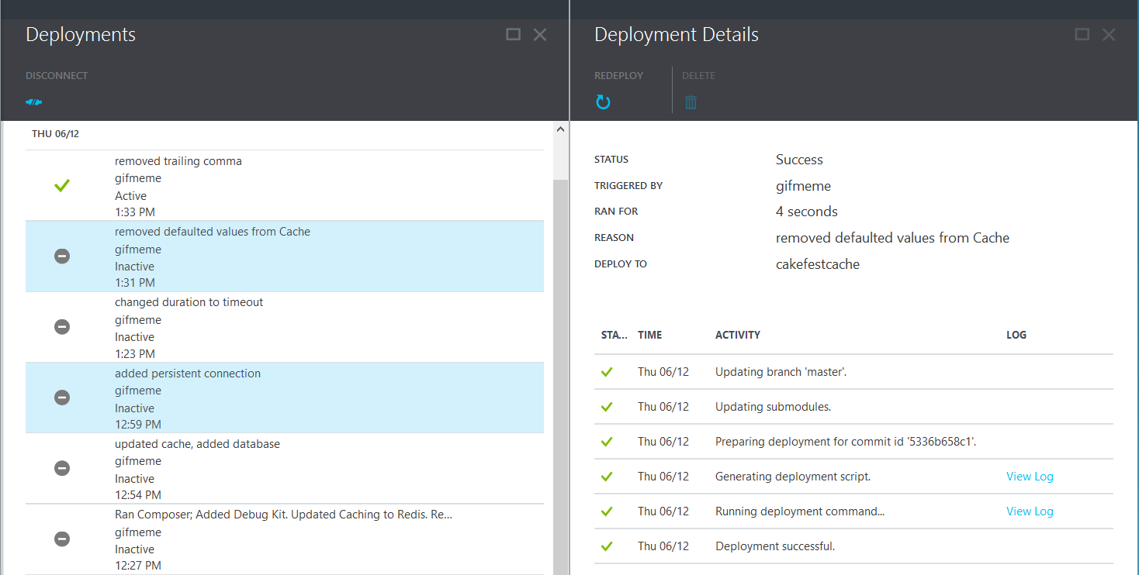
Deployments

Slide 25
Deployment Avançado
KUDU
Azure Websites Migration Assistant
Website Slots
Publicação em Staging

Slide 26
Deployment Avançado
Azure Website
Source Control Provider
Staged Slot
IDE

Slide 27
FTP Deployment WebDeploy Deployment Continuous Integration Deployment

Slide 28
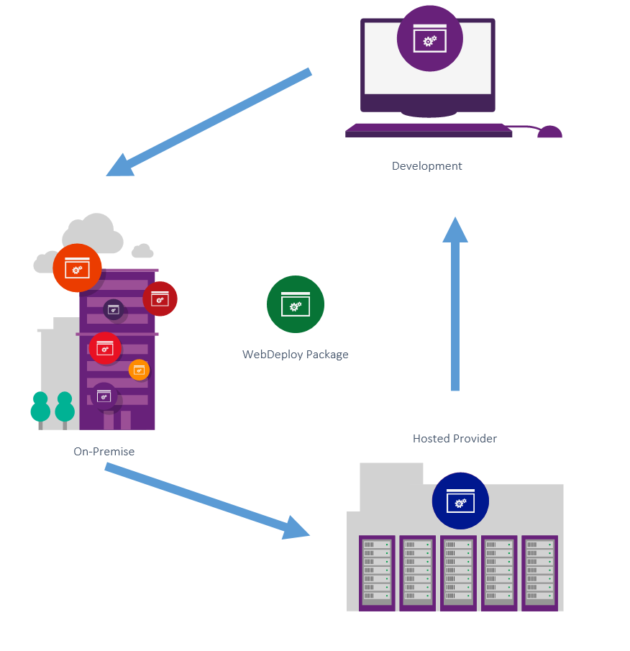
WebDeploy

Slide 29
Deployment Slots

Slide 30
Introdução
Deployment slots possibilitam a criação de um processo de deployment robusto permitindo deployment direto em produção;
Quando você cria um Azure WebApp, você provisiona automaticamente um slot de produção que representa o seu website quando estiver publicado no Microsoft Azure;
Notes:
Deployment slots enable you to perform more robust deployment workflows than deploying your website directly to production. When you create an Azure website, you are automatically provisioned with a production slot that represents your live website. With each deployment slot, you can create up to four additional deployment slots (for a total of five) that you can swap with the production slot (or even with other non-production slots). When you swap, the site content and certain slot configurations are exchanged with no downtime. This is useful in the following scenarios:
Tejada, Zoiner; Bustamante, Michele Leroux; Ellis, Ike. Exam Ref 70-532 Developing Microsoft Azure Solutions (pp. 2-3). Pearson Education. Kindle Edition.

Slide 31
Introdução
Limitação de 5 deployments slots por WebApp
Você pode criar até 4 deployments slots adicionais (totalizando 5) que você poderá “trocar” para o slot de produção ou qualquer um outro slot que você deseja:
Exemplo: Desenvolvimento, Homologação, Testes, Pré produção etc
Quando você troca para um determinado Deployment Slot, oconteúdo do site e algumas configurações do slot são trocadas sem nenhum downtime.
Notes:
Deployment slots enable you to perform more robust deployment workflows than deploying your website directly to production. When you create an Azure website, you are automatically provisioned with a production slot that represents your live website. With each deployment slot, you can create up to four additional deployment slots (for a total of five) that you can swap with the production slot (or even with other non-production slots). When you swap, the site content and certain slot configurations are exchanged with no downtime. This is useful in the following scenarios:
Tejada, Zoiner; Bustamante, Michele Leroux; Ellis, Ike. Exam Ref 70-532 Developing Microsoft Azure Solutions (pp. 2-3). Pearson Education. Kindle Edition.

Slide 32
Cenários de Utilizaçãp
Staged deployment
Em um staged deployment, você implanta em um slot não produção que está atuando como um ambiente de staging. Neste ambiente, você testa se todo o website está funcionando como o esperado e quando você se certificada de que está tudo funcionando, você realiza a troca para o slot de produção.
Notes:
Staged deployment
In a staged deployment, you deploy to a non-production slot that is acting as a staging environment. In this environment, you test whether the website is working as expected, and when you are satisfied that it is, you swap the production slot with the staging slot, making the staged content and certain parts of the configuration the new production website.
Tejada, Zoiner; Bustamante, Michele Leroux; Ellis, Ike. Exam Ref 70-532 Developing Microsoft Azure Solutions (p. 3). Pearson Education. Kindle Edition.

Slide 33
Cenários de Utilizaçãp
Incremental deployment
Se o deployment do seu website inclui passos incrementais que você precisa para realizar um deployment depois, você pode implantar em um slot de não produção, realizar as configurações e então, realizar a troca de slots para o slot de produção e finalizar a atualização do website;
Rolling back deployment
If, after swapping a non-production slot into production, you need to roll back the deployment, you can swap the production slot again with the slot that contains the previous production content and configuration, thereby rolling back the deployment.
Notes:
Incremental deployment
If your website deployment includes incremental steps that you need to take post-deployment, you can deploy to a non-production slot, make those changes, and then swap with the production slot to make the updated website live.
Rolling back deployment
If, after swapping a non-production slot into production, you need to roll back the deployment, you can swap the production slot again with the slot that contains the previous production content and configuration, thereby rolling back the deployment.
Tejada, Zoiner; Bustamante, Michele Leroux; Ellis, Ike. Exam Ref 70-532 Developing Microsoft Azure Solutions (p. 3). Pearson Education. Kindle Edition.

Slide 34

Staging
Web App

Slide 35
Preparando e configurando ambientes de staging
Notes:
http://azure.microsoft.com/en-us/documentation/articles/web-sites-staged-publishing/

Slide 36


Configurando e Monitorando

Slide 37
Web Hosting Plans (Planos de Hospedagem)
Web Hosting Plans can logically group Websites within a subscription.
Characteristics such as features, capacity and tiers are shared amongst the Website instance in the group.
Zero-to-many Web Hosting Plans can exist in a Resource Group and Zero-to-many Websites can exist in a Web Hosting Plan.

Slide 38
Web Hosting Plans (Planos de Hospedagem)
Shared Plan
Plano Compartilhado
Testar WebSites
Free Plan
Plano Gratuito
Dev Website
QA Website
Basic A3 Plan
Plano Básico A3
Website Público
B2B Webservices
Demo Website

Slide 39
Gerenciando Web Hosting Plans (Planos de Hospedagens)

Slide 40
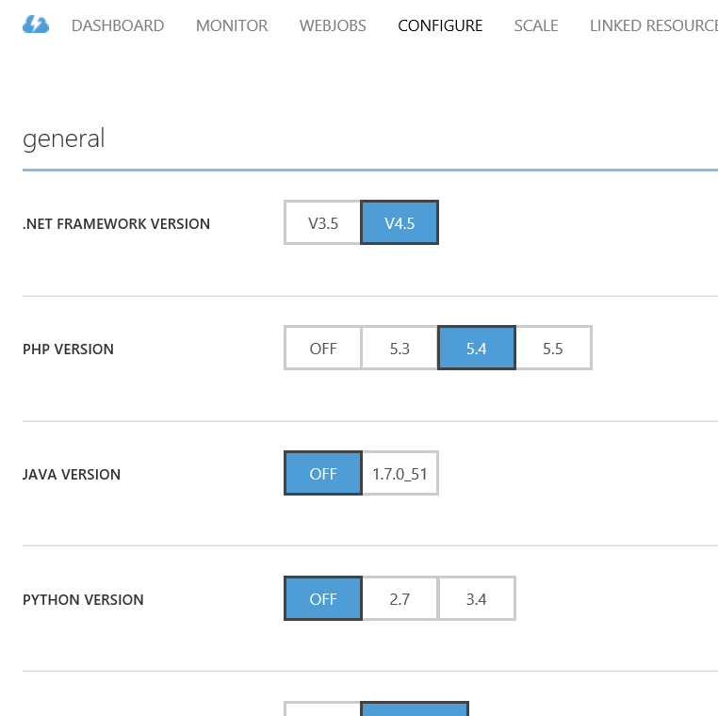
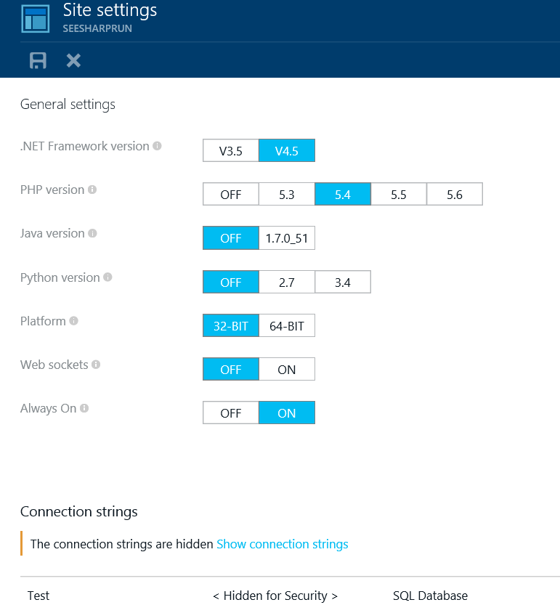
Configurando WebApps
Portal Atual
Novo Portal

Slide 41
Diagnostics & Monitoring
HTTP Logs
Error Logs
Portal Monitoring
Log Streaming
Application Insights
Notes:
Git Deployment is Native, or through a Service hook from CodePlex, GitHub or BitBucket

Slide 42
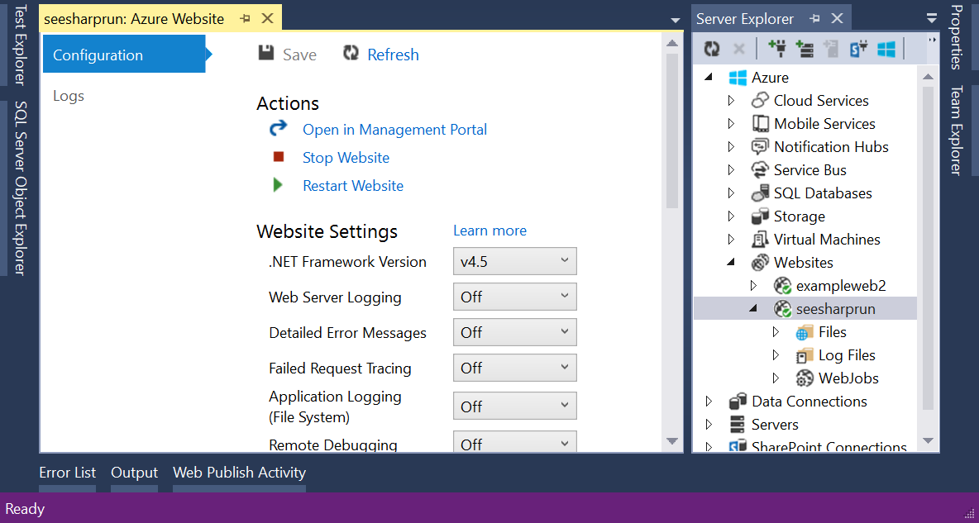
Configurando WebApps
Automação
PowerShell
Bibliotecas Cliente (Client Libraries)
.NET, Java, Python
Xplat CLI
IDE
Visual Studio

Slide 43
Configurando Log Streaming e Remote Debugging

Slide 44

Web Jobs

Slide 45
Web Jobs
Host (Hospedagem) e agendamento de tarefas em um WebApp Existente;
Disparado uma vez, por agendamento ou rodar continuamente;
Experiência através de Dashboard;
.NET SDK e Templates de Projeto do Visual Studio;
Método de Binding para o Azure Services
Blobs
Queues

Slide 46






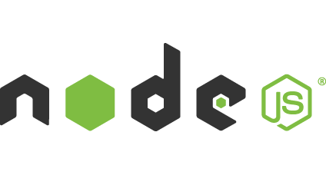
Light-weight CPU Intensive Tasks
run.cmd, run.bat
run.exe
run.ps1
run.sh
run.php
run.py
run.js
Job Type:
On-Demand, Scheduled, Continuous
Scale:
Singleton, Multi-instance
WebJobs SDK Feature:
BlobTrigger, TableTrigger, QueueTrigger, ServicebusTrigger
Deployment:
Portal, Visual Studio, CLI, Git

Slide 47
WebJobs
Web App

Slide 48
WebJobs
Web App

Slide 49
Criando um WebJob Básico

Slide 50

Escala e Resiliência

Slide 51
Web Site Scale and Resilience
Autoscale
Moldar sua solução para melhor se “encaixar/adaptar” a utilização dos recursos do Azure WebApp;
Suportado nas opções Standard/Basic do Web Hosting Plan (Plano de Hospedagem)
Novo portal suporta métricas extendidas
Percentual de memória, Tamanho das Filas no Disco, Tamanho das filas HTTP, Data In/Out
Traffic Manager
Load Balancer
Performance
Round Robin
Failover
Distribuir serviços em todas as regiões do Microsoft Azure.

Slide 52
Scale Manual
Instance Count
1
6
Instances

Slide 53
AutoScale
Web App

Slide 54
AutoScale
Web App

Slide 55
AutoScale
Web App

Slide 56
Auto-Scaling (Métricas)
Instance Count
2
6
Instances
[Metric]
60
80
Percent
CPU Percentage
Memory Percentage
Disk Queue Length
HTTP Queue Length
Data In
Data Out

Slide 57
AutoScale
Rule
Web App
CPU: 40%
Notes:
You will illustrate an AutoScale rule of a Web App.
Speaker notes.
You will be explaining autoscale rule example with CPU as the metric, threshold greater 70% and Duration time of 15 minutes before the first autoscale action is performed. This example rule has a Cool down time of 15 minutes before next autoscale action is performed if the usage of the CPU continues to be above the threshold value. Autoscale Action will increase number of instances for the Web App by 1 in this example.
The AutoScale rule is best demonstrated by following this sequence of transitions.
Show traffic increase <click>
Show CPU usage spike above 70% <click>
Show with timer 15 minutes of Duration<click>
Show a new instance of Web App is being provisioned <click>
Show with timer 15 minutes of Cool down time <click>
Show another instance of Web App being provisioned<click>

Slide 58
AutoScale
Rule
Web App
CPU: 40%
Duration
CPU: 70%-90%
Cool down

Slide 59
Configurando Autoscale

Slide 60
Hands on Labs
Management Portal
ASPNETAzureWebSites
Get started with WebApps and ASP.NET
HOL-ASPNETAzureWebSitesTFS
HOL-GettingStartedAzurePreviewPortal

